Slide 1
RULE BASED Content PLAYER
Institute of Technology, Nirma University
Submitted By:
Patel Akash(15BIT029)
Nikita Dandwani(15BCE075)
Guided By:
Prof. Usha Patel
Prof. Meenaxi Tank
Industry Guides:
Padmanabhan,
Sanjna Hans,
Shreekhar,
Akshaya Raghunath

Slide 2
Introduction
This project is based on small module of Lex(lexcampus.infosysapps.com)
Module is totally based on Frontend.
JSON file has been used as a Database.
This project is all about creating customize content player catering to needs of user.
Content here means the learning material that will be provided to user so that he can create his own learning path.
Rule here means based on learning path decided by user, Content will be shown to user.
Player is the common interface that will show these material.
Frontend Technology: Angular 7

Slide 3

Lexcampus.infosysapps.com

Slide 4
Components OF the Project
Course List
Content Player

Slide 5
Services Used in Project
Master Engine
Rule Schema Reader
Rule
Resource
Resource Meta Data Reader
Course
Previous Resource Id

Slide 6
Json Files
Json\Course.json.txt
Json\Rule.json.txt
Json\Resource.json.txt
Json\Question.json.txt
Json\Test.json.txt

Slide 7
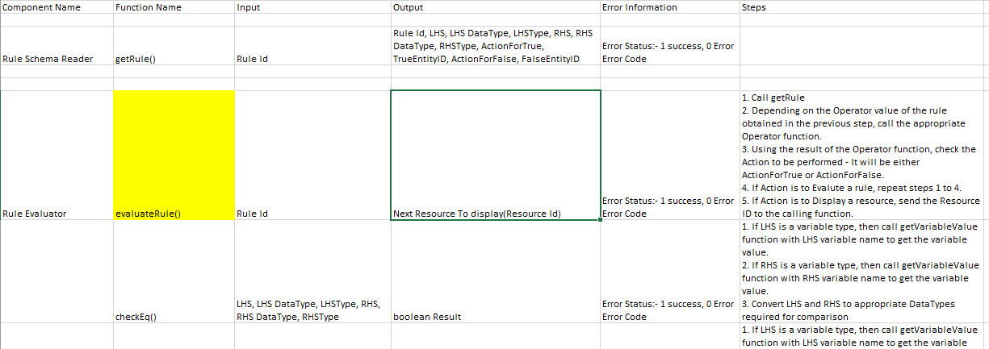
FUNCTIONALITIES

Slide 8
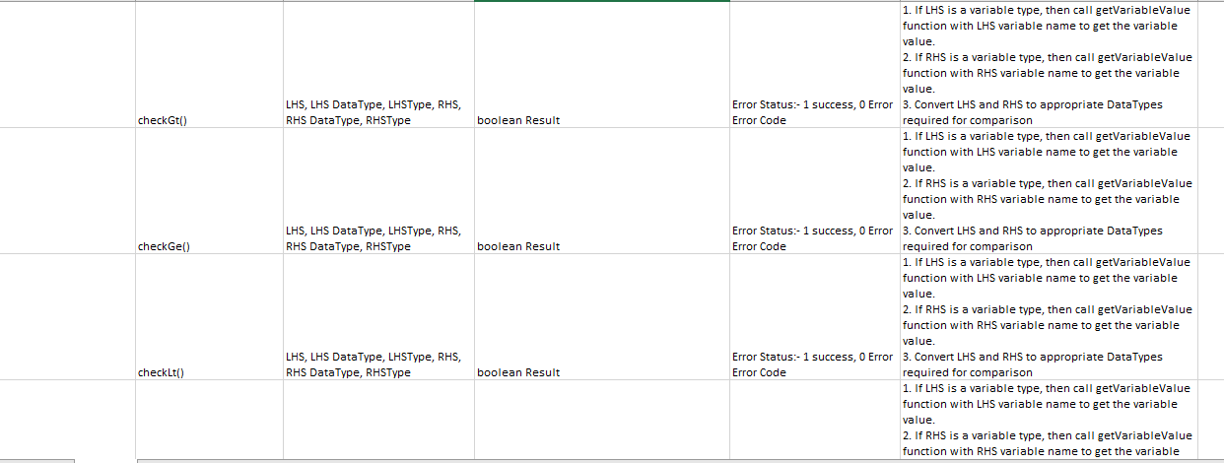
Functionalities

Slide 9
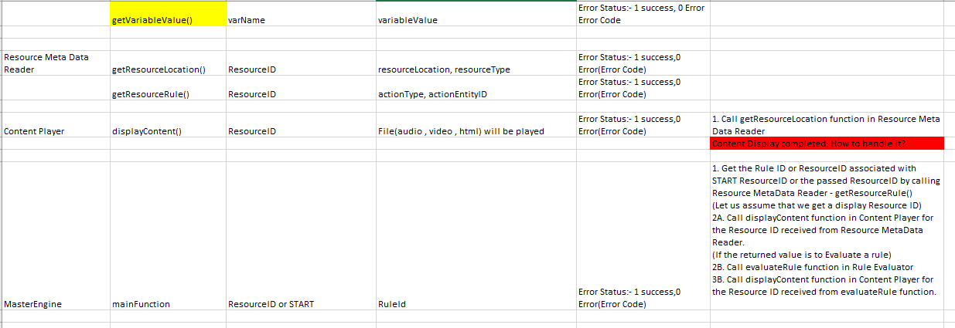
FUNCTIONALITIES

Slide 10
Flow Diagram
..\Diagrams\Flow Diagram RBCP.png
..\Diagrams\Normal Flow.png

Slide 11
Variable Store
VariableStore\course.txt
VariableStore\actionEntity.txt
VariableStore\playerParameter.txt
VariableStore\resourceExpression.txt
VariableStore\resourceLocation.txt
VariableStore\ruleExpression.txt
VariableStore\rulelocation.txt
VariableStore\variableObject.txt
VariableStore\variableBox.txt

Slide 12
Training Summary
Part 1- Generic Training: Learnt the basics of Python Programming, Database Management, OOPS concept.
Part2- Stream Training -I: Learnt Java and advance Concepts of Java, Logging, Testing using JUNIT.
Part3- Stream training-II: Learnt Spring, Hibernate, API building, Spring REST, Angular, Bootstrap.
Part4- Project: Working and applying concepts of stream training in a real time project in Agile Manner.

Slide 13
THANK you

